Slide 1
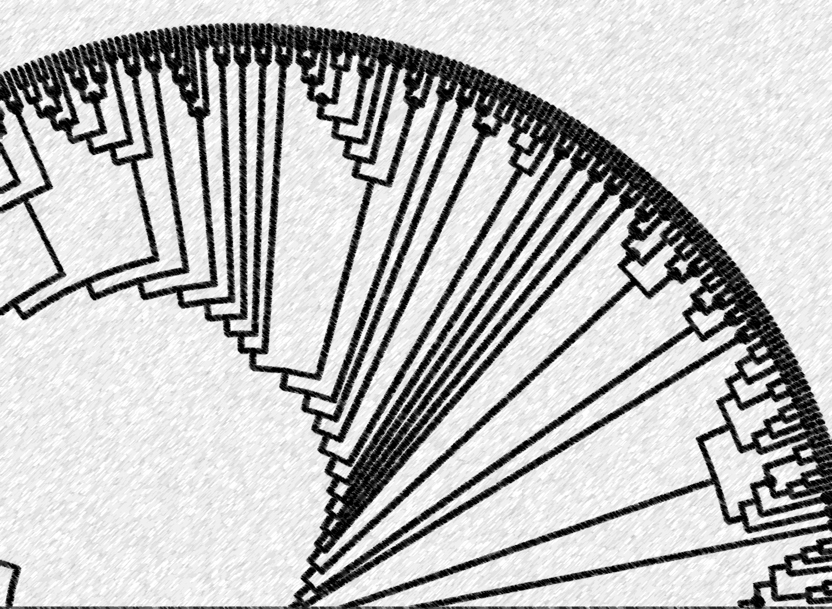
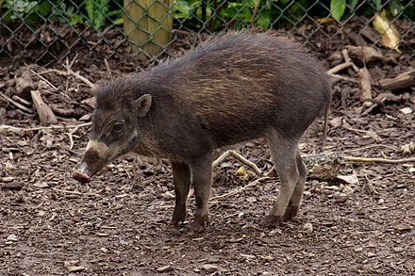
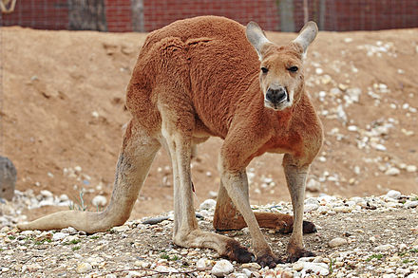
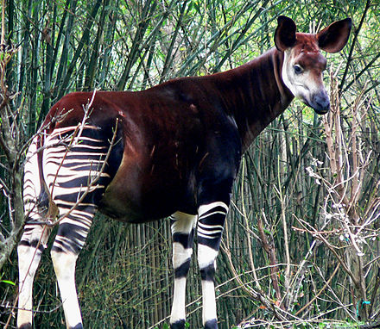
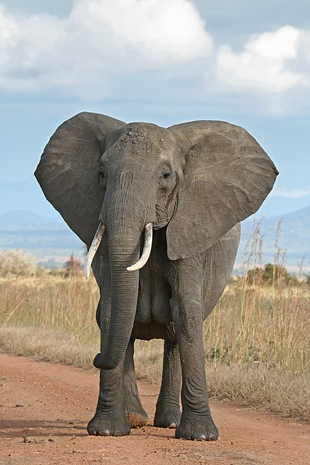
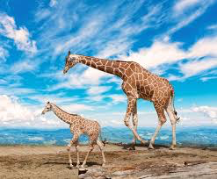
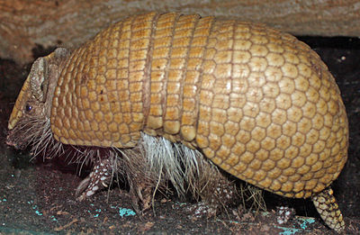
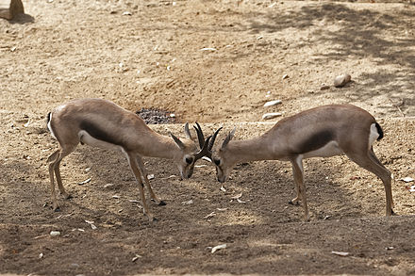
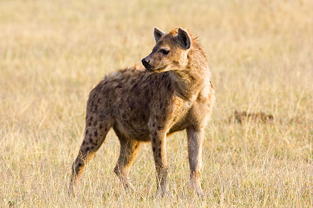
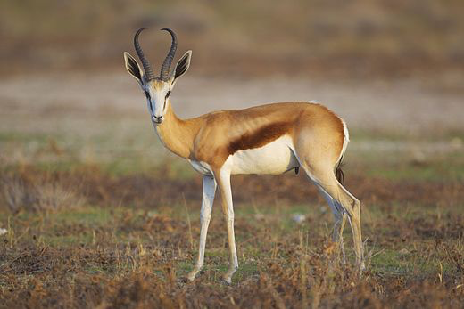
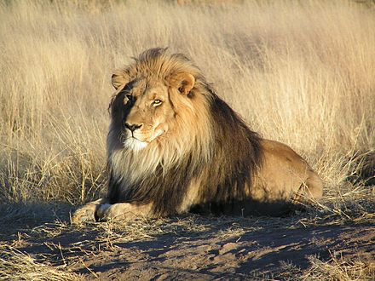
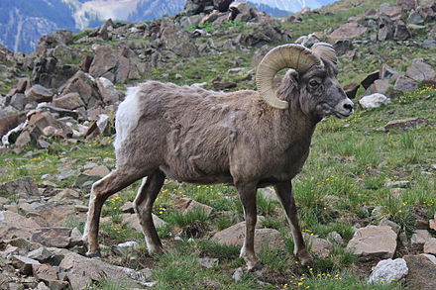
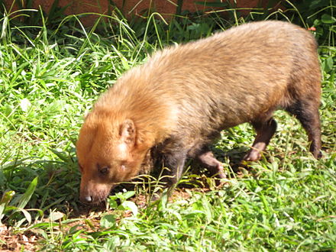
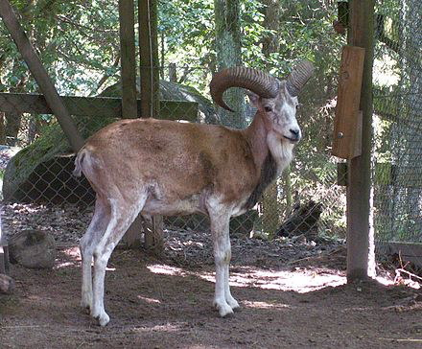
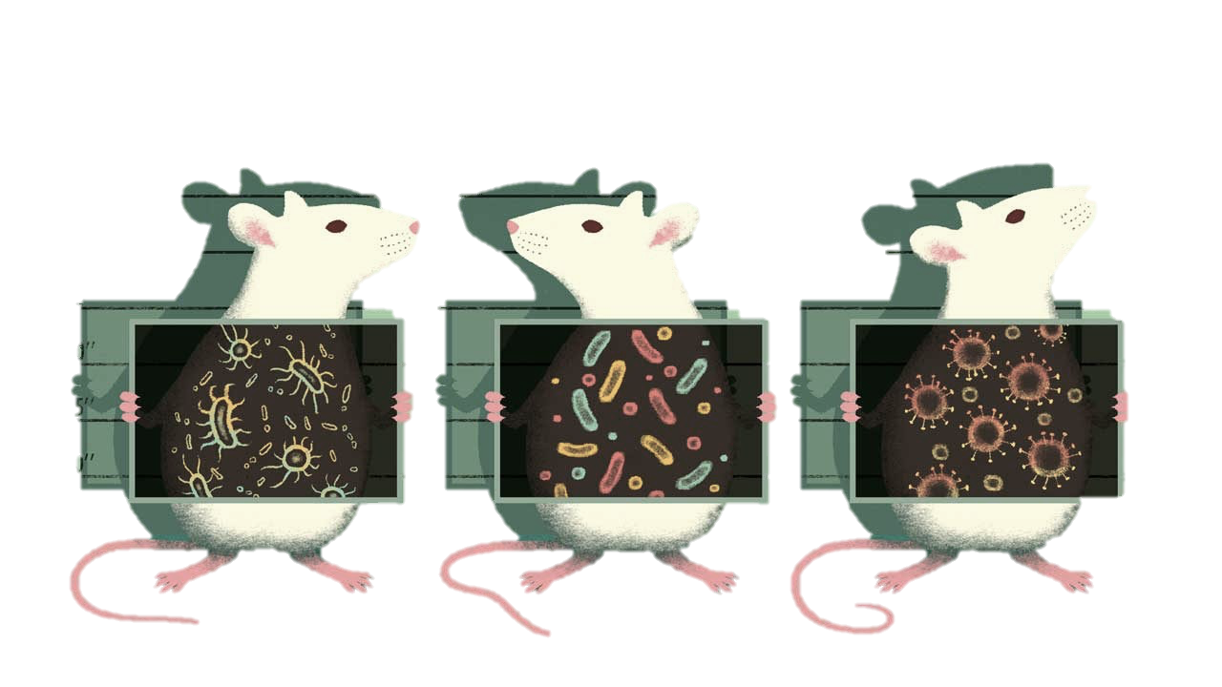
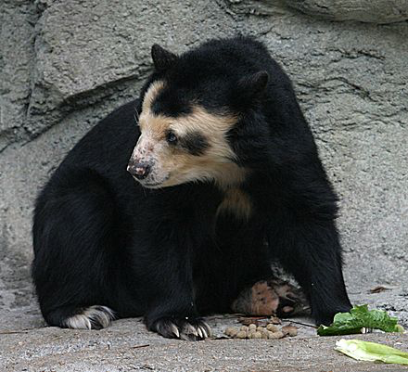
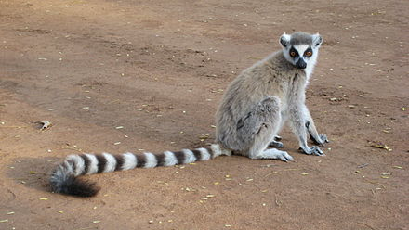
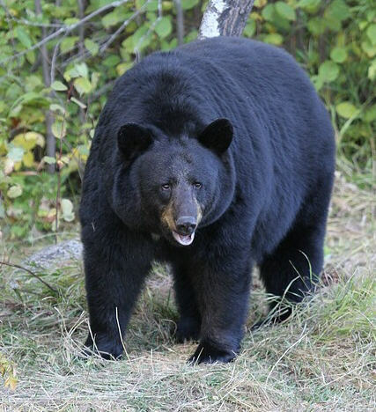
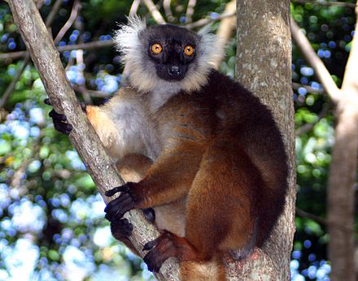
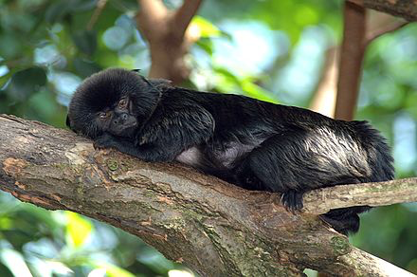
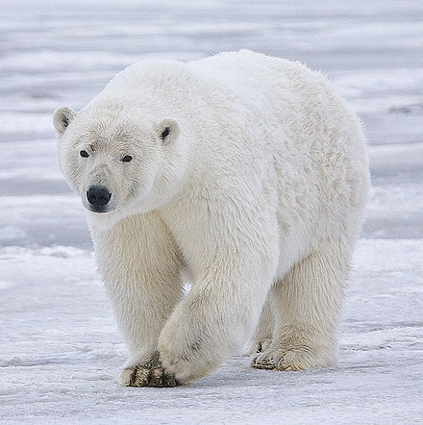
Cladal Taxonomic Unit Discovery
ClaaTU: a new bioinformatic tool to incorporate microbial phylogeny into microbial community analysis
Holly Arnold
DVM PhD Candidate
Holly.K.Arnold@gmail.com
Sharpton Lab
September 13th, 2018
ClaaTU Workshop

Slide 2
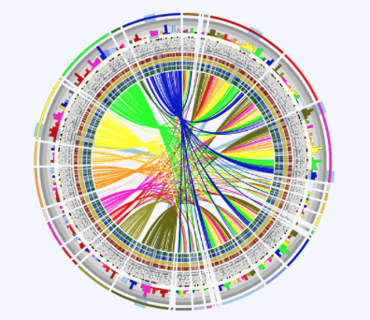
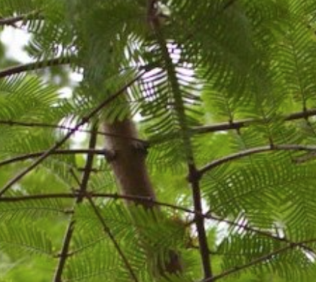
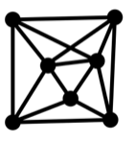
Cladal Taxonomic Unit (ClaaTU)
ACKNOWLEDGEMENTS
Sharpton Lab – Oregon State
Thomas Sharpton
Christopher Gaulke
Courtney Armour
Ian Humphreys
Nichole Kirchoff
Keaton Stagaman
Quinn Washburn
Steve Kembel Lab
UQAM
James O’Dwyer Lab
University of Illinois

Slide 3
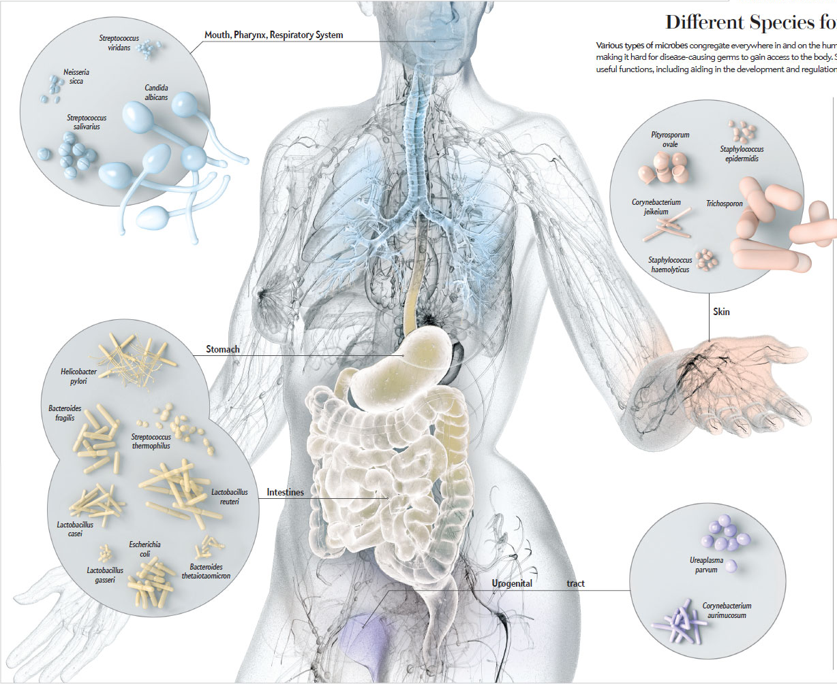
The Animal Microbiome
MOTIVATION
Microbiota
Resistance to pathogens
Modification of the nervous system
Nutrient acquisition
Modulation of the immune system
Biosynthesis of vitamins and amino acids
Metabolism of toxins and xenobiotics
Microbiota
IBD
Autoimmunity
Type II diabetes
Liver disease: Cirrhosis
Metabolic syndrome
Obesity

Slide 4
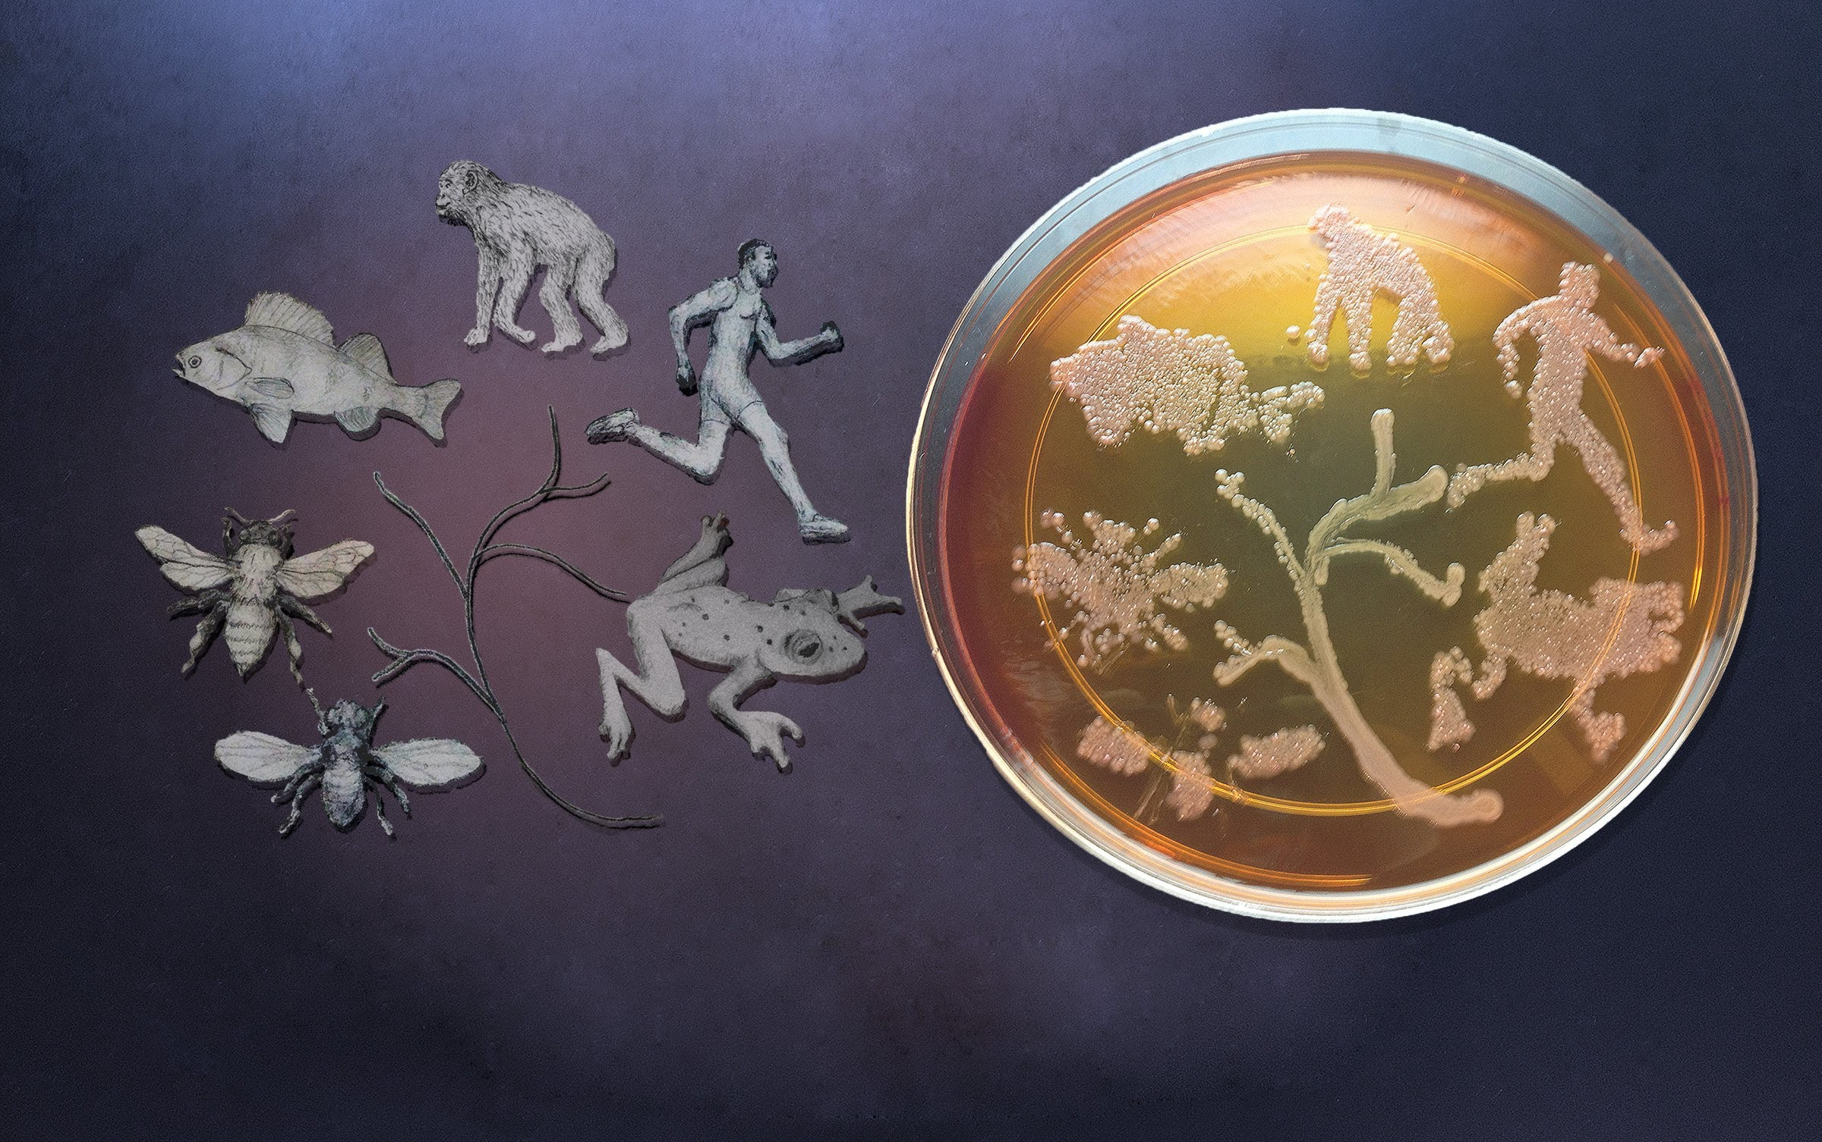
The Animal Microbiome
MOTIVATION

Slide 5
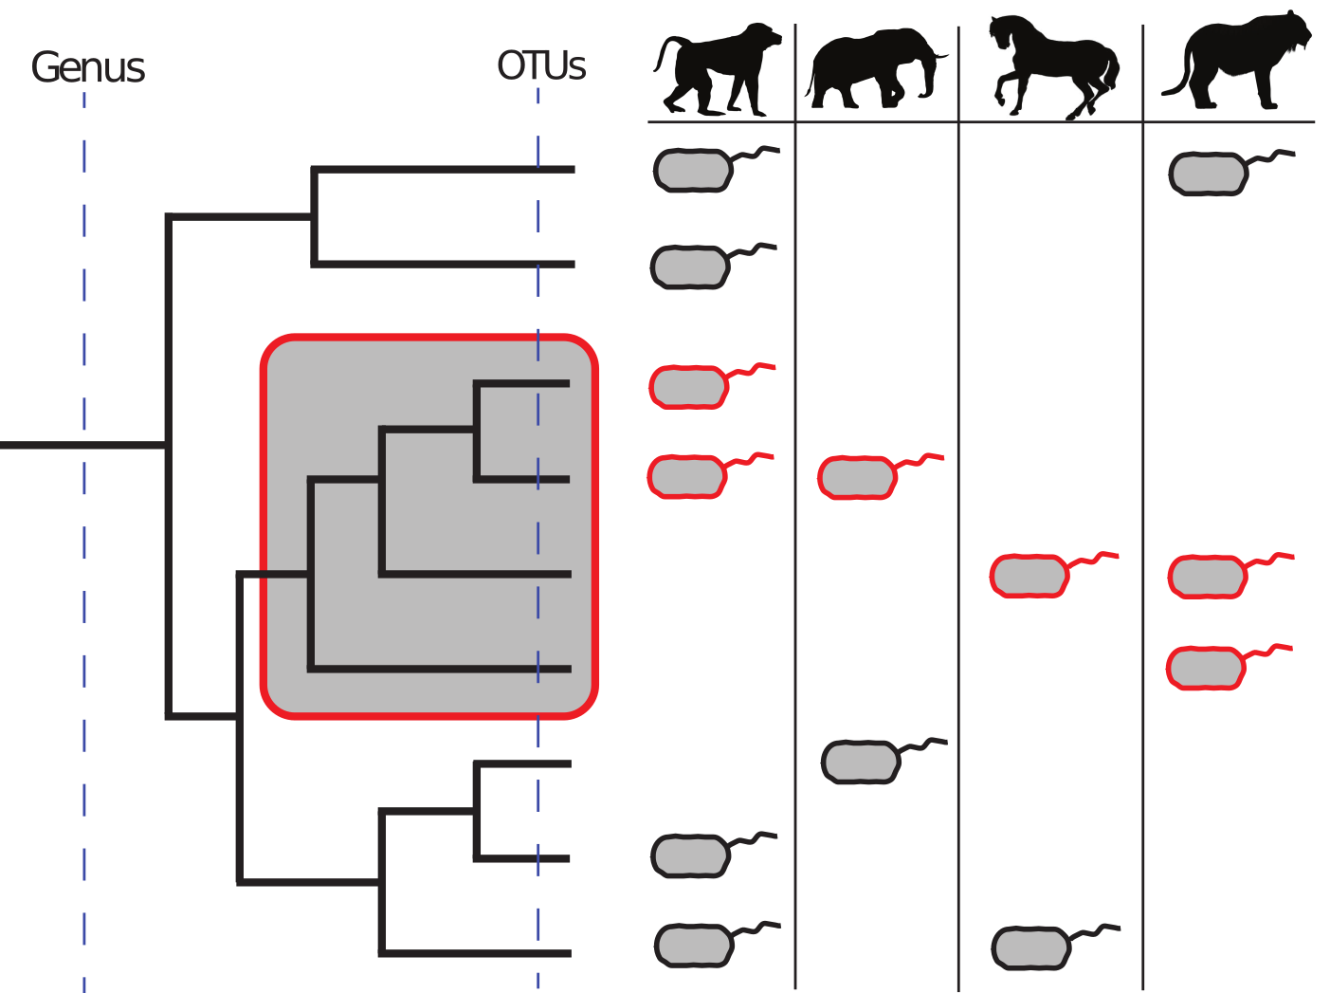
Methods utilizing the phylogenetic structure of the microbiome are lacking
MOTIVATION
Currently, each microbe is considered as independent of others, which ignores the inherent phylogenetic covariance structure present within the microbial community data.
Animal Species
Microbial Species

Slide 6
Methods utilizing the phylogenetic structure of the microbiome are lacking
MOTIVATION
Incorporation of phylogeny into analysis may improve our understanding of which bacteria associate and are conserved across mammals.
Animal Species

Slide 7
Methods utilizing the phylogenetic structure of the microbiome are lacking
MOTIVATION
Incorporation of phylogeny into analysis may improve our understanding of which bacteria associate and are conserved across mammals.
Animal Species
Monophylytic clade := a group of organisms all sharing a common ancestor

Slide 8
Methods utilizing the phylogenetic structure of the microbiome are lacking
MOTIVATION
Incorporation of phylogeny into analysis may improve our understanding of which bacteria associate and are conserved across mammals.
Animal Species
Monophylytic clade := a group of organisms all sharing a common ancestor
Cladal Taxonomic Unit (CTU) := a group of organisms all sharing a common ancestor that are statistically conserved among mammals.

Slide 9
The Animal Microbiome
MOTIVATION
Are there microbial lineages conserved across mammalian hosts?
Are there microbial lineages conserved across mammalian orders?

Slide 10
Methods utilizing the phylogenetic structure of the microbiome are lacking
MOTIVATION
Incorporation of phylogeny into analysis may improve our understanding of which microbial lineages associate with [your favorite ecological variable here].
Animal Species
Monophylytic clade := a group of organisms all sharing a common ancestor
Cladal Taxonomic Unit (CTU) := a group of organisms all sharing a common ancestor that manifest a statistical relationship with some ecological covariate.

Slide 11
Methods utilizing the phylogenetic structure of the microbiome are lacking
MOTIVATION
A CTU reflects a group of taxa that have potentially evolved a conserved trait which associates with that ecological variable
Animal Species
Monophylytic clade := a group of organisms all sharing a common ancestor
Cladal Taxonomic Unit (CTU) := a group of organisms all sharing a common ancestor that manifest a statistical relationship with some ecological covariate.

Slide 12
Workshop Goals
OVERVIEW
Understand how ClaaTU works, and how it differs from other commonly used methods
Be able to implement ClaaTU on your own data
Have some ideas on downstream data analysis of the ClaaTU output.

Slide 13
Workshop Outline
OVERVIEW
ClaaTU Overview
Tutorial
Visualization
Minitopics
Considerations for dada2
Managing python packages with Conda
Apply ClaaTU to your own data

Slide 14
Workshop Outline
OVERVIEW
ClaaTU Overview
Tutorial
Visualization
Minitopics
Considerations for dada2
Managing python packages with Conda
Apply ClaaTU to your own data

Slide 15
Workshop Outline
OVERVIEW
ClaaTU Overview
Tutorial
Visualization
Minitopics
Considerations for dada2
Managing python packages with Conda
Apply ClaaTU to your own data
Motivation
Understand how ClaaTU is different from other tools available
Understand how this tool provides a new dimensionality to microbial community data
Theory
Understand how the ClaaTU Algorithm works

Slide 16
Workshop Outline
OVERVIEW
ClaaTU Overview
Tutorial
Visualization
Minitopics
Considerations for dada2
Managing python packages with Conda
Apply ClaaTU to your own data
Motivation
Understand how ClaaTU is different from other tools available
Understand how this tool provides a new dimensionality to microbial community data
Theory
Understand how the ClaaTU Algorithm works

Slide 17
Claadal Taxonomic Units can distill patterns that OTUs cannot
MOTIVATION
ClaaTU conducts an exhaustive root to tip tree traversal and examines cladal distributions at every bifrucation of the phylogenetic tree.
ClaaTU then determines CTUs, or clades manifest statistical signal for your ecological covariate of interest using a permutation test.

Slide 18
Workshop Outline
OVERVIEW
ClaaTU Overview
Tutorial
Visualization
Minitopics
Considerations for dada2
Managing python packages with Conda
Apply ClaaTU to your own data
Motivation
Understand how ClaaTU is different from other tools available
Understand how this tool provides a new dimensionality to microbial community data
Theory
Understand how the ClaaTU Algorithm works

Slide 19
Workshop Outline
OVERVIEW
ClaaTU Overview
Tutorial
Visualization
Minitopics
Considerations for dada2
Managing python packages with Conda
Apply ClaaTU to your own data
Motivation
Understand how ClaaTU is different from other tools available
Understand how this tool provides a new dimensionality to microbial community data
Theory
Understand how the ClaaTU Algorithm works

Slide 20
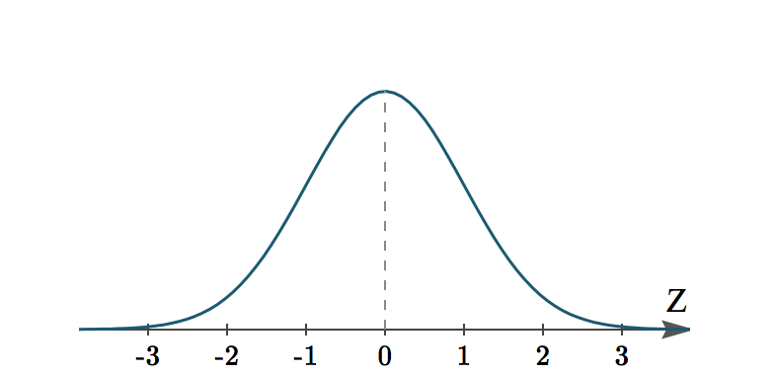
Cladal Diversity Matrix
Clade Stats
Identify statistically overrepresented clades (CTUs)
Taxonomically Label Clades
THEORY
Cladal Diversity
Matrix
Permutation Test
Clade Taxonomy
Shuffle OTU Matrix
Shuffled clade coreness
CTU Matrix

Slide 21
Cladal Diversity Matrix
Clade Stats
Identify statistically overrepresented clades
Taxonomically Label Clades
THEORY

Slide 22
Cladal Diversity Matrix
Clade Stats
Identify statistically overrepresented clades
Taxonomically Label Clades
THEORY

Slide 23
Cladal Diversity Matrix
Clade Stats
Identify statistically overrepresented clades
Taxonomically Label Clades
THEORY

Slide 24
Cladal Diversity Matrix
Clade Stats
Identify statistically overrepresented clades
Taxonomically Label Clades
THEORY
Cladal Diversity Matrix

Slide 25
Cladal Diversity Matrix
Clade Stats
Identify statistically overrepresented clades
Taxonomically Label Clades
THEORY

Slide 26
Cladal Diversity Matrix
Clade Stats
Identify statistically overrepresented clades
Taxonomically Label Clades
THEORY

Slide 27
Cladal Diversity Matrix
Clade Stats
Identify statistically overrepresented clades
Taxonomically Label Clades
THEORY

Slide 28
Cladal Diversity Matrix
Clade Stats
Identify statistically overrepresented clades
Taxonomically Label Clades
THEORY

Slide 29
Cladal Diversity Matrix
Clade Stats
Identify statistically overrepresented clades
Taxonomically Label Clades
THEORY

Slide 30
Cladal Diversity Matrix
Clade Stats
Identify statistically overrepresented clades
Taxonomically Label Clades
THEORY

Slide 31
Cladal Diversity Matrix
Clade Stats
Identify statistically overrepresented clades
Taxonomically Label Clades
THEORY

Slide 32
Cladal Diversity Matrix
Clade Stats
Identify statistically overrepresented clades
Taxonomically Label Clades
THEORY

Slide 33
Cladal Diversity Matrix
Clade Stats
Identify statistically overrepresented clades
Taxonomically Label Clades
THEORY
7

Slide 34
Cladal Diversity Matrix
Clade Stats
Identify statistically overrepresented clades
Taxonomically Label Clades
THEORY
7

Slide 35
Cladal Diversity Matrix
Clade Stats
Identify statistically overrepresented clades
Taxonomically Label Clades
THEORY
Cladal Diversity
Matrix

Slide 36
Cladal Diversity Matrix
Clade Stats
Identify statistically overrepresented clades
Taxonomically Label Clades
THEORY
Cladal Diversity
Matrix
OTU | Kingdom | Phylum | Class | Order | Family | Genus | Species
OTU1 | Bacteria | Firmicutes | Clostridia | Clostridiales | Ruminococcaceae | Ruminococcus | flavefaciens
OTU2 | Bacteria | Firmicutes | Clostridia | Clostridiales | Ruminococcaceae | Ruminococcus | Sp.
OTU3 | Bacteria | Firmicutes | Clostridia | Clostridiales | Ruminococcaceae | NA | NA
OTU4 | Bacteria | Firmicutes | Clostridia | Clostridiales | Ruminococcaceae | Ruminococcus | flavefaciens
OTU5 | Bacteria | Firmicutes | Clostridia | Clostridiales | Clostridiaceae | Faecalibacterium | prausnitzii
OTU6 | Bacteria | Firmicutes | Clostridia | Clostridiales | Lachnospiraceae | Blautia | sp

Slide 37
Cladal Diversity Matrix
Clade Stats
Identify statistically overrepresented clades
Taxonomically Label Clades
THEORY
Cladal Diversity
Matrix
OTU | Kingdom | Phylum | Class | Order | Family | Genus | Species
OTU1 | Bacteria | Firmicutes | Clostridia | Clostridiales | Ruminococcaceae | Ruminococcus | flavefaciens
OTU2 | Bacteria | Firmicutes | Clostridia | Clostridiales | Ruminococcaceae | Ruminococcus | Sp.
OTU3 | Bacteria | Firmicutes | Clostridia | Clostridiales | Ruminococcaceae | NA | NA
OTU4 | Bacteria | Firmicutes | Clostridia | Clostridiales | Ruminococcaceae | Ruminococcus | flavefaciens
OTU5 | Bacteria | Firmicutes | Clostridia | Clostridiales | Clostridiaceae | Faecalibacterium | prausnitzii
OTU6 | Bacteria | Firmicutes | Clostridia | Clostridiales | Lachnospiraceae | Blautia | sp

Slide 38
Cladal Diversity Matrix
Clade Stats
Identify statistically overrepresented clades
Taxonomically Label Clades
THEORY
Cladal Diversity
Matrix
OTU | Kingdom | Phylum | Class | Order | Family | Genus | Species
OTU1 | Bacteria | Firmicutes | Clostridia | Clostridiales | Ruminococcaceae | Ruminococcus | flavefaciens
OTU2 | Bacteria | Firmicutes | Clostridia | Clostridiales | Ruminococcaceae | Ruminococcus | Sp.
OTU3 | Bacteria | Firmicutes | Clostridia | Clostridiales | Ruminococcaceae | NA | NA
OTU4 | Bacteria | Firmicutes | Clostridia | Clostridiales | Ruminococcaceae | Ruminococcus | flavefaciens
OTU5 | Bacteria | Firmicutes | Clostridia | Clostridiales | Clostridiaceae | Faecalibacterium | prausnitzii
OTU6 | Bacteria | Firmicutes | Clostridia | Clostridiales | Lachnospiraceae | Blautia | sp

Slide 39
Cladal Diversity Matrix
Clade Stats
Identify statistically overrepresented clades
Taxonomically Label Clades
THEORY
Cladal Diversity
Matrix
OTU | Kingdom | Phylum | Class | Order | Family | Genus | Species
OTU1 | Bacteria | Firmicutes | Clostridia | Clostridiales | Ruminococcaceae | Ruminococcus | flavefaciens
OTU2 | Bacteria | Firmicutes | Clostridia | Clostridiales | Ruminococcaceae | Ruminococcus | Sp.
OTU3 | Bacteria | Firmicutes | Clostridia | Clostridiales | Ruminococcaceae | NA | NA
OTU4 | Bacteria | Firmicutes | Clostridia | Clostridiales | Ruminococcaceae | Ruminococcus | flavefaciens
OTU5 | Bacteria | Firmicutes | Clostridia | Clostridiales | Clostridiaceae | Faecalibacterium | prausnitzii
OTU6 | Bacteria | Firmicutes | Clostridia | Clostridiales | Lachnospiraceae | Blautia | sp

Slide 40
Cladal Diversity Matrix
Clade Stats
Identify statistically overrepresented clades
Taxonomically Label Clades
THEORY
Cladal Diversity
Matrix
Clade Taxonomy

Slide 41
Cladal Diversity Matrix
Clade Stats
Identify statistically overrepresented clades
Taxonomically Label Clades
THEORY
Cladal Diversity
Matrix
Clade Taxonomy

Slide 42
Cladal Diversity Matrix
Clade Stats
Identify statistically overrepresented clades
Taxonomically Label Clades
THEORY
Cladal Diversity
Matrix
Clade Taxonomy

Slide 43
Cladal Diversity Matrix
Clade Stats
Identify statistically overrepresented clades
Taxonomically Label Clades
THEORY
Cladal Diversity
Matrix
Clade Taxonomy

Slide 44
Cladal Diversity Matrix
Clade Stats
Identify statistically overrepresented clades (CTUs)
Taxonomically Label Clades
THEORY
Cladal Diversity
Matrix
Clade Taxonomy

Slide 45
Cladal Diversity Matrix
Clade Stats
Identify statistically overrepresented clades (CTUs)
Taxonomically Label Clades
THEORY
Cladal Diversity
Matrix
Cladal Taxonomic Unit (CTU) := a group of organisms all sharing a common ancestor that manifest a statistical relationship with some ecological covariate.
Clade Taxonomy

Slide 46
Cladal Diversity Matrix
Clade Stats
Identify statistically overrepresented clades (CTUs)
Taxonomically Label Clades
THEORY
Cladal Diversity
Matrix
A p-value is calculated for every clade, which indicates the likelihood that this clade wound manifest this conservation rate across samples based on tree structure and sample distribution
Clade Taxonomy

Slide 47
Cladal Diversity Matrix
Clade Stats
Identify statistically overrepresented clades (CTUs)
Taxonomically Label Clades
THEORY
Calculate an observed clade coreness for each clade
Clade coreness := the percentage of samples in which clade X is present within samples
For i in 1:<number_permutations>
Shuffle the tree tips to OTU labels
Recalculate the cladal diversity matrix
Calculates a shuffled clade coreness
Obtain a Z-score by how observed clade coreness relates to shuffled clade coreness
Calculate a p-value from the Z-score

Slide 48
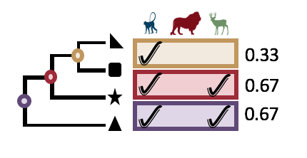
Cladal Diversity Matrix
Clade Stats
Identify statistically overrepresented clades (CTUs)
Taxonomically Label Clades
THEORY
Calculate an observed clade coreness for each clade
Clade coreness := the percentage of samples in which clade X is present within samples
For i in 1:<number_permutations>
Shuffle the tree tips to OTU labels
Recalculate the cladal diversity matrix
Calculates a shuffled clade coreness
Obtain a Z-score by how observed clade coreness relates to shuffled clade coreness
Calculate a p-value from the Z-score

Slide 49
Cladal Diversity Matrix
Clade Stats
Identify statistically overrepresented clades (CTUs)
Taxonomically Label Clades
THEORY
Calculate an observed clade coreness for each clade
Clade coreness := the percentage of samples in which clade X is present within samples
For i in 1:<number_permutations>
Shuffle the tree tips to OTU labels
Recalculate the cladal diversity matrix
Calculates a shuffled clade coreness
Obtain a Z-score by how observed clade coreness relates to shuffled clade coreness
Calculate a p-value from the Z-score

Slide 50
Cladal Taxonomic Unit Matrix
Clade Stats
Identify statistically overrepresented clades
Taxonomically Label Clades
THEORY

Slide 51
Cladal Diversity Matrix
Clade Stats
Identify statistically overrepresented clades (CTUs)
Taxonomically Label Clades
THEORY
Calculate an observed clade coreness for each clade
Clade coreness := the percentage of samples in which clade X is present within samples
For i in 1:<number_permutations>
Shuffle the tree tips to OTU labels
Recalculate the cladal diversity matrix
Calculates a shuffled clade coreness
Obtain a Z-score by how observed clade coreness relates to shuffled clade coreness
Calculate a p-value from the Z-score

Slide 52
Cladal Diversity Matrix
Clade Stats
Identify statistically overrepresented clades (CTUs)
Taxonomically Label Clades
THEORY
Calculate an observed clade coreness for each clade
Clade coreness := the percentage of samples in which clade X is present within samples
For i in 1:<number_permutations>
Shuffle the tree tips to OTU labels
Recalculate the cladal diversity matrix
Calculates a shuffled clade coreness
Obtain a Z-score by how observed clade coreness relates to shuffled clade coreness
Calculate a p-value from the Z-score

Slide 53
Cladal Diversity Matrix
Clade Stats
Identify statistically overrepresented clades (CTUs)
Taxonomically Label Clades
THEORY
Calculate an observed clade coreness for each clade
Clade coreness := the percentage of samples in which clade X is present within samples
For i in 1:<number_permutations>
Shuffle the tree tips to OTU labels
Recalculate the cladal diversity matrix
Calculates a shuffled clade coreness
Obtain a Z-score by how observed clade coreness relates to shuffled clade coreness
Calculate a p-value from the Z-score
P-Value

Slide 54
Cladal Diversity Matrix
Clade Stats
Identify statistically overrepresented clades (CTUs)
Taxonomically Label Clades
THEORY
Cladal Diversity
Matrix
Permutation Test
Clade Taxonomy
Shuffle OTU Matrix
Shuffled clade coreness
CTU Matrix

Slide 55
Cladal Diversity Matrix
Clade Stats
Identify statistically overrepresented clades (CTUs)
Taxonomically Label Clades
THEORY
Calculate an observed group clade coreness for each clade
Clade group coreness := the percentage of samples in which clade X is present within samples from group Y
For i in 1:<number_permutations>
Shuffle the tree tips to OTU labels
Recalculate the cladal diversity matrix
Calculates a shuffled group clade coreness
Obtain a Z-score by how observed group clade coreness relates to shuffled group clade coreness
Calculate a p-value from the Z-score

Slide 56
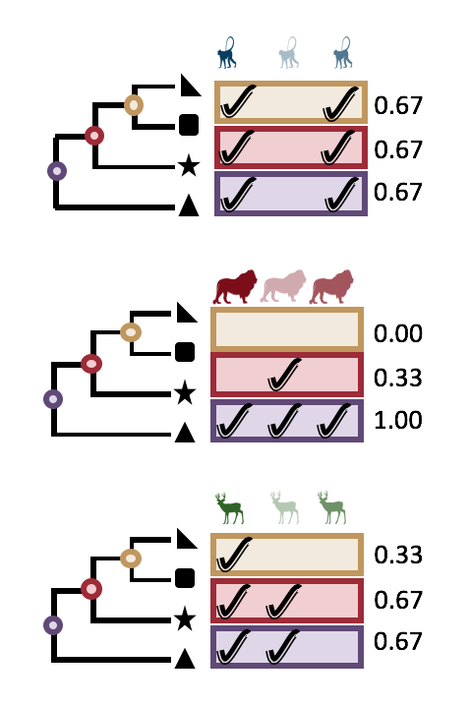
Cladal Diversity Matrix
Clade Stats
Identify statistically overrepresented clades (CTUs)
Taxonomically Label Clades
THEORY
Calculate an observed group clade coreness for each clade
Clade group coreness := the percentage of samples in which clade X is present within samples from group Y
For i in 1:<number_permutations>
Shuffle the tree tips to OTU labels
Recalculate the cladal diversity matrix
Calculates a shuffled group clade coreness
Obtain a Z-score by how observed group clade coreness relates to shuffled group clade coreness
Calculate a p-value from the Z-score

Slide 57
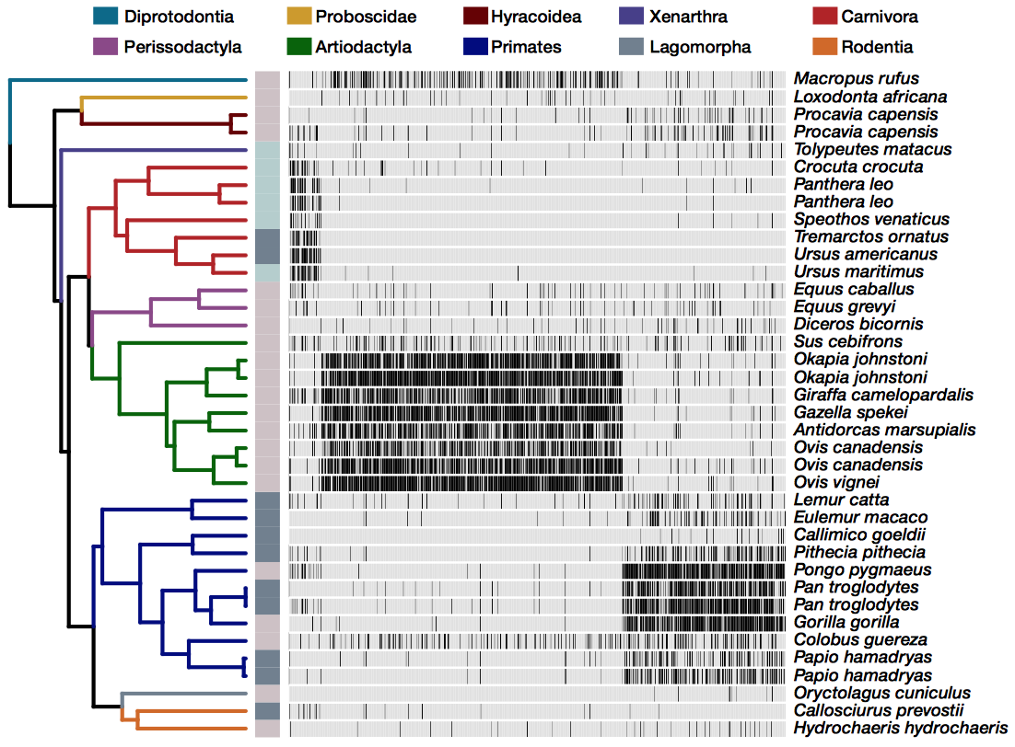

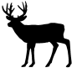

Tutorial Dataset: Gut Microbiome 22 Animal species, 612 OTUs
TUTORIAL
Order
Carnivora
Artiodactyla
Diet
Primates

Slide 58
Cladal Diversity Matrix
Clade Stats
Identify statistically overrepresented clades (CTUs)
Taxonomically Label Clades
THEORY
Calculate an observed group clade coreness for each clade
Clade group coreness := the percentage of samples in which clade X is present within samples from group Y
For i in 1:<number_permutations>
Shuffle the tree tips to OTU labels
Recalculate the cladal diversity matrix
Calculates a shuffled group clade coreness
Obtain a Z-score by how observed group clade coreness relates to shuffled group clade coreness
Calculate a p-value from the Z-score

Slide 59
Cladal Diversity Matrix
Clade Stats
Identify statistically overrepresented clades (CTUs)
Taxonomically Label Clades
THEORY
Calculate an observed group clade coreness for each clade
Clade group coreness := the percentage of samples in which clade X is present within samples from group Y
For i in 1:<number_permutations>
Shuffle the tree tips to OTU labels
Recalculate the cladal diversity matrix
Calculates a shuffled group clade coreness
Obtain a Z-score by how observed group clade coreness relates to shuffled group clade coreness
Calculate a p-value from the Z-score
P-Value

Slide 60
Workshop Outline
OVERVIEW
ClaaTU Overview
Tutorial
Visualization
Minitopics
Considerations for dada2
Managing python packages with Conda
Apply ClaaTU to your own data

Slide 61
Workshop Outline
OVERVIEW
ClaaTU Overview
Tutorial
Visualization
Minitopics
Considerations for dada2
Managing python packages with Conda
Apply ClaaTU to your own data
Follow along and copy past code at:
http://rpubs.com/arnoldhk/claatu_tutorial
Log onto the server
User: claatuUser<#>@acer.uqam.ca –X
Password: claatu
Example:
ssh claatuUser2@acer.uqam.ca -X
claatu

Slide 62
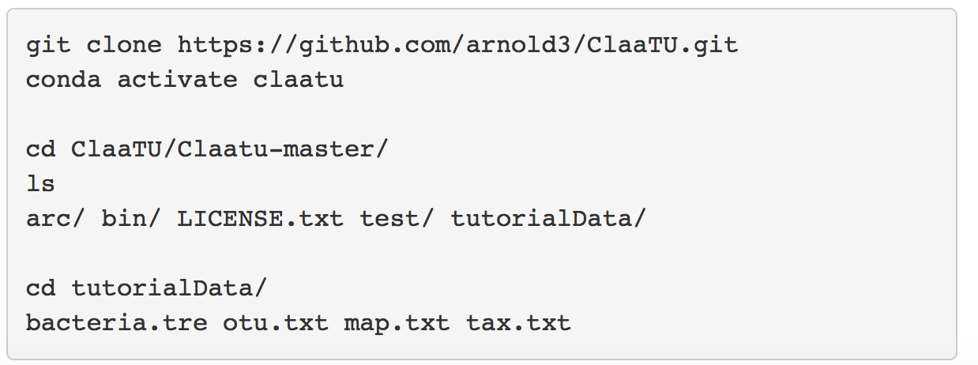
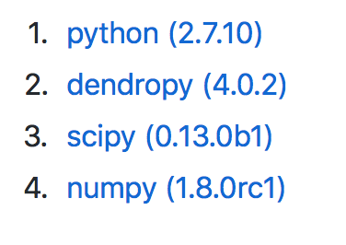
Install
TUTORIAL

Slide 63
Tutorial Dataset: Gut Microbiome 22 Animal species, 612 OTUs
TUTORIAL
Order
Carnivora
Artiodactyla
Diet
Primates

Slide 64
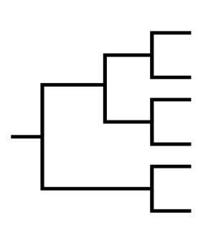
Input Files
TUTORIAL
bac.tre
Sample Names
otu.txt
#OTU ID
otu.txt
bac.tre
tax.txt
map.txt
+/- groupMap.txt
OTU Names
OTU Names
tax.txt
map.txt
OTU Names
Sample Names

Slide 65
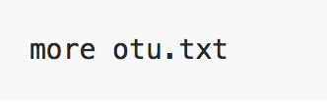
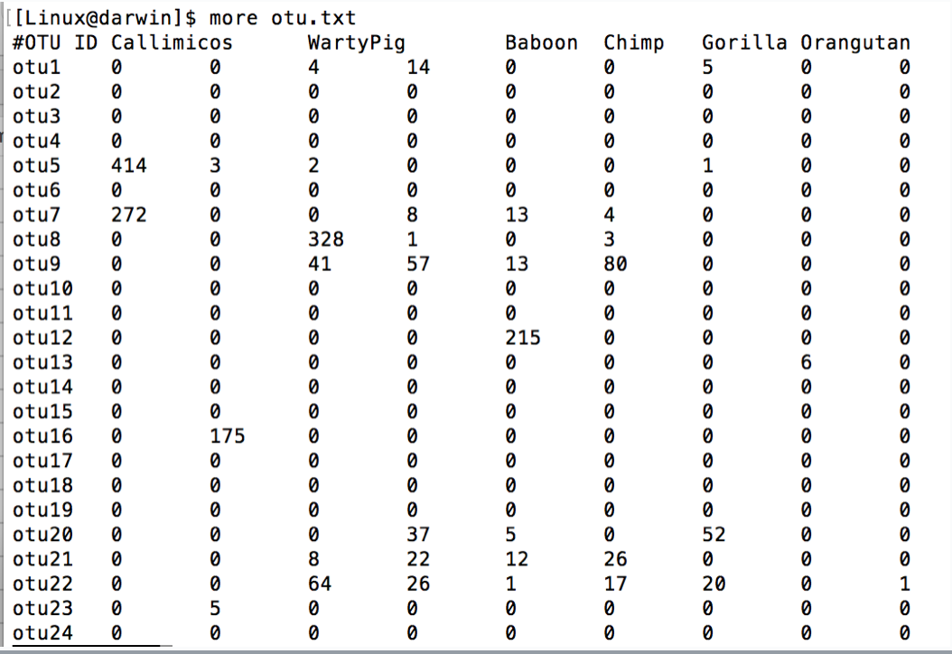
Input File Requirements
TUTORIAL
otu.txt
All entries must be tab separated.
#OTU ID before the table.
Yes, that is a #OTU<space>ID<tab>.
Row names are otu names
Column names are sample IDs

Slide 66
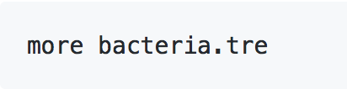
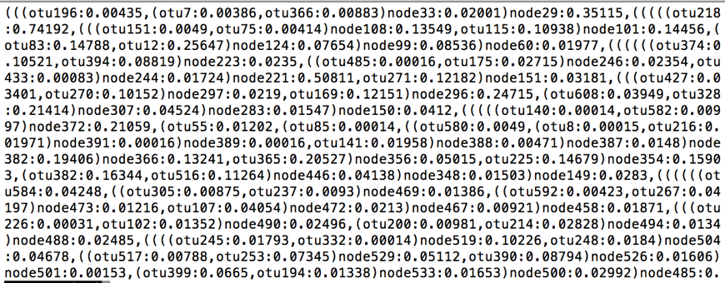
Input File Requirements
TUTORIAL
bacteria.tre
Newick Format
Tip labels must exactly match our OTU table row names

Slide 67
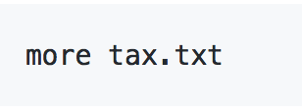
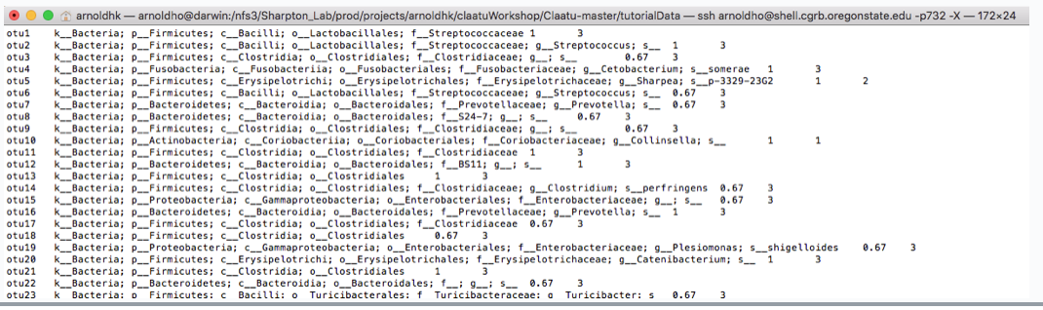
Input File Requirements
TUTORIAL
tax.txt
OTU tax labels must exactly match our OTU table row names
The tax column is one column with k__Bacteria;<space>p…<\t>

Slide 68
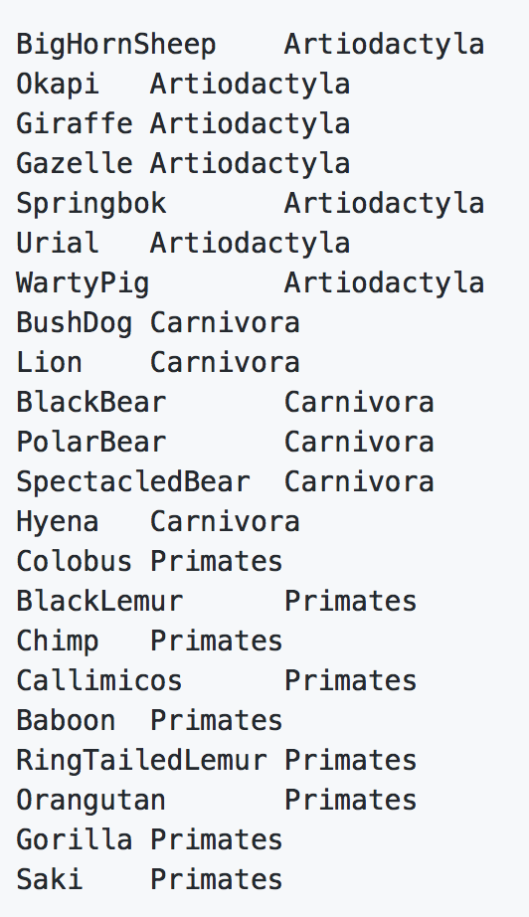
Input File Requirements
TUTORIAL
groupMap.txt
Contains exactly two columns
Column 1: exactly match the column labels in OTU.txt
Column 2: Contains the group ID for each sample. In this case we have three different mammalian taxonomic orders, so we see there are only three unique group IDs.

Slide 69
Input Files
TUTORIAL
bac.tre
Sample Names
otu.txt
#OTU ID
otu.txt
bac.tre
tax.txt
map.txt
+/- groupMap.txt
OTU Names
OTU Names
tax.txt
map.txt
OTU Names
Sample Names

Slide 70
Cladal Diversity Matrix
Clade Stats
Identify statistically overrepresented clades (CTUs)
Taxonomically Label Clades
THEORY
Cladal Diversity
Matrix
Permutation Test
Clade Taxonomy
Shuffle OTU Matrix
Shuffled clade coreness
CTU Matrix

Slide 71
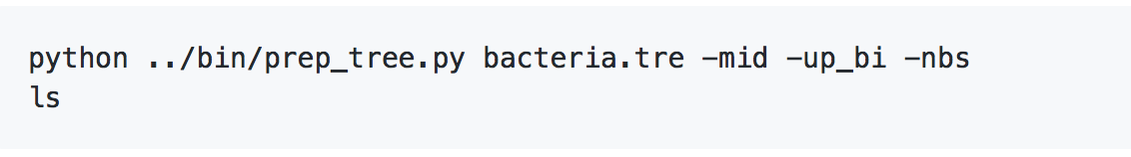
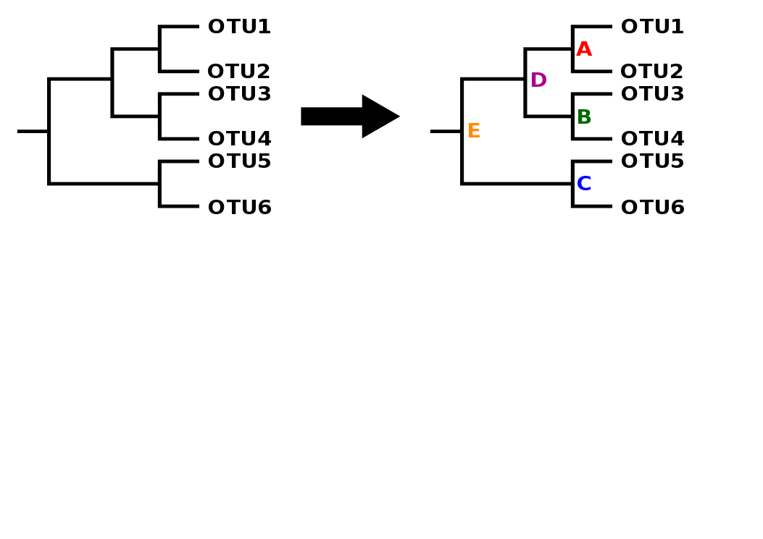
Step 1A: Prepare Tree
Cladal Diversity Matrix
Clade Stats
Identify statistically overrepresented clades
Taxonomically Label Clades
TUTORIAL
Cladal Diversity
Matrix

Slide 72
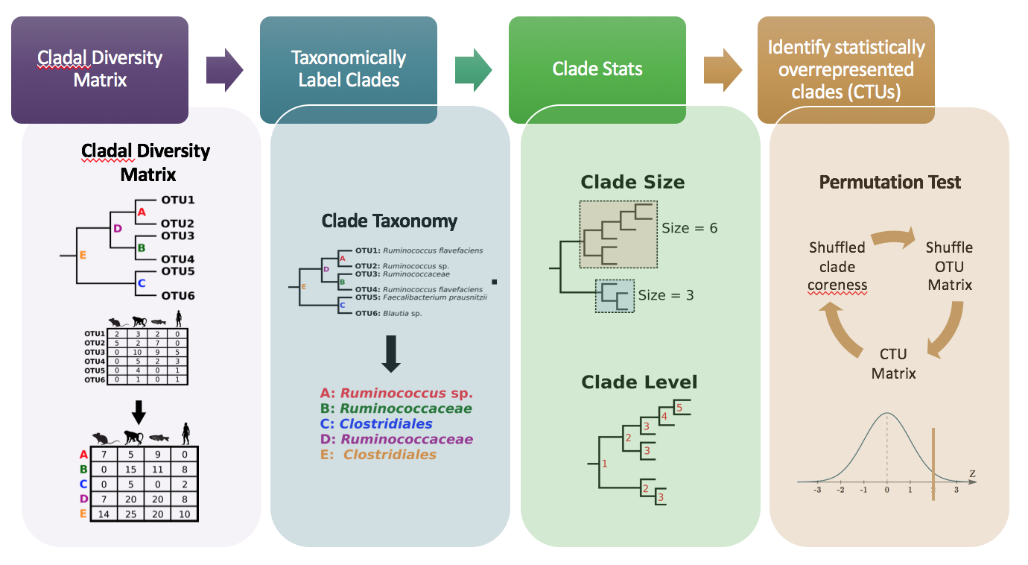
Output files
new_prepped_tree.tre
ctus.txt
cladeStat_nodes2tax.txt
tax_clades.txt
cladeStat_clade_size.txt
node_info_dist_median.txt
node_info_dist.txt
node_info_levels.txt
ptest.txt
ptest.txt_stats.txt
groupPtest.txt
groupPtest.txt_stats.txt

Slide 73
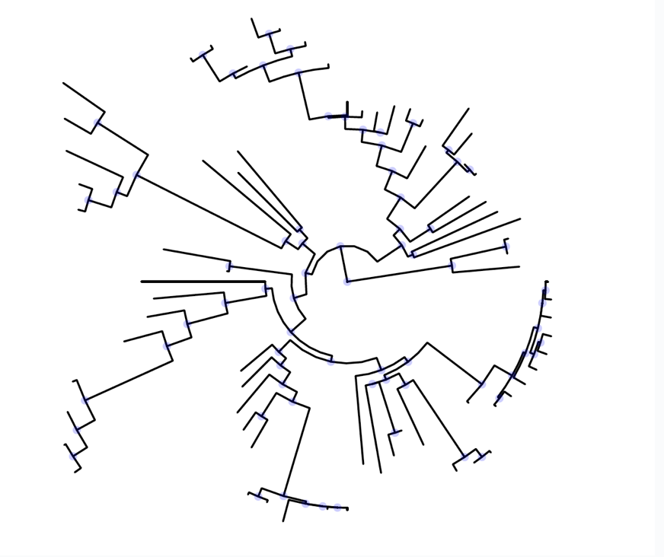
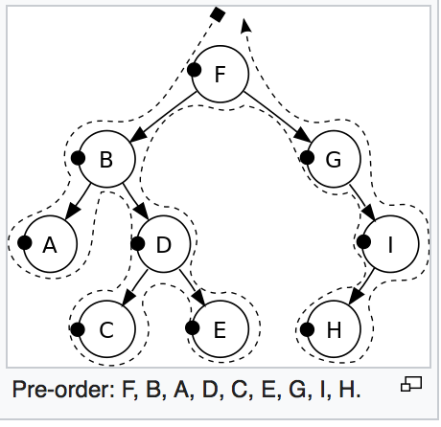
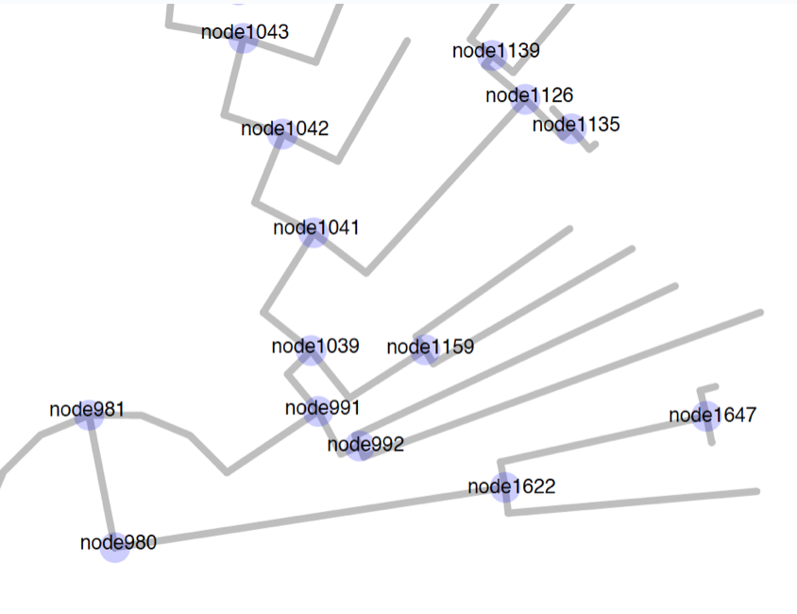
Step 1A: Prepare Tree
Cladal Diversity Matrix
Clade Stats
Identify statistically overrepresented clades
Taxonomically Label Clades
TUTORIAL
Cladal Diversity
Matrix

Slide 74
Step 1B: CTU Matrix
Cladal Diversity Matrix
Clade Stats
Identify statistically overrepresented clades
Taxonomically Label Clades
TUTORIAL
Cladal Diversity
Matrix
bac.tre
OTU Names
Node Names
ctu.txt
Sample Names
Sample Names
otu.txt
OTU Names

Slide 75
Output files
new_prepped_tree.tre
ctus.txt
cladeStat_nodes2tax.txt
tax_clades.txt
cladeStat_clade_size.txt
node_info_dist_median.txt
node_info_dist.txt
node_info_levels.txt
ptest.txt
ptest.txt_stats.txt
groupPtest.txt
groupPtest.txt_stats.txt

Slide 76
Cladal Diversity Matrix
Clade Stats
Identify statistically overrepresented clades (CTUs)
Taxonomically Label Clades
THEORY
Cladal Diversity
Matrix
Permutation Test
Clade Taxonomy
Shuffle OTU Matrix
Shuffled clade coreness
CTU Matrix

Slide 77
Cladal Diversity Matrix
Clade Stats
Identify statistically overrepresented clades
Taxonomically Label Clades
THEORY
Cladal Diversity
Matrix
Clade Taxonomy

Slide 78
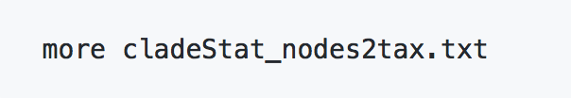
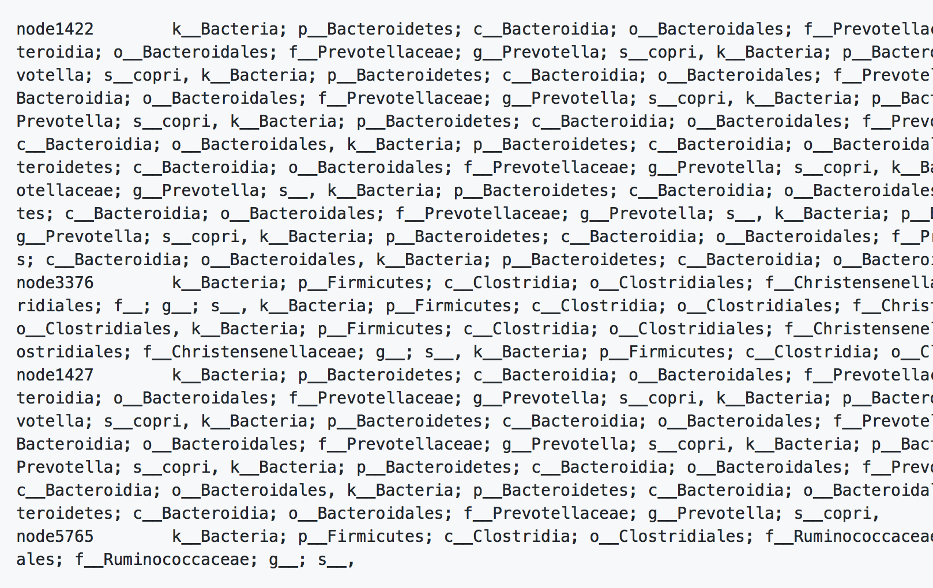
Step 2A: Get Taxonomy
Cladal Taxonomic Unit Matrix
Clade Stats
Identify statistically overrepresented clades
Taxonomically Label Clades
TUTORIAL
Clade Taxonomy

Slide 79
Output files
new_prepped_tree.tre
ctus.txt
cladeStat_nodes2tax.txt
tax_clades.txt
cladeStat_clade_size.txt
node_info_dist_median.txt
node_info_dist.txt
node_info_levels.txt
ptest.txt
ptest.txt_stats.txt
groupPtest.txt
groupPtest.txt_stats.txt

Slide 80

Step 2B: Get Taxonomy
Cladal Taxonomic Unit Matrix
Clade Stats
Identify statistically overrepresented clades
Taxonomically Label Clades
TUTORIAL
Clade Taxonomy

Slide 81
Output files
new_prepped_tree.tre
ctus.txt
cladeStat_nodes2tax.txt
tax_clades.txt
cladeStat_clade_size.txt
node_info_dist_median.txt
node_info_dist.txt
node_info_levels.txt
ptest.txt
ptest.txt_stats.txt
groupPtest.txt
groupPtest.txt_stats.txt

Slide 82
Cladal Diversity Matrix
Clade Stats
Identify statistically overrepresented clades
Taxonomically Label Clades
THEORY
Cladal Diversity
Matrix
Permutation Test
Clade Taxonomy
Shuffle OTU Matrix
Shuffled clade coreness
CTU Matrix

Slide 83
Step 3: Get Clade Stats
Cladal Taxonomic Unit Matrix
Clade Stats
Identify statistically overrepresented clades
Taxonomically Label Clades
TUTORIAL

Slide 84
Output files
new_prepped_tree.tre
ctus.txt
cladeStat_nodes2tax.txt
tax_clades.txt
cladeStat_clade_size.txt
node_info_dist_median.txt
node_info_dist.txt
node_info_levels.txt
ptest.txt
ptest.txt_stats.txt
groupPtest.txt
groupPtest.txt_stats.txt

Slide 85
Cladal Diversity Matrix
Clade Stats
Identify statistically overrepresented clades (CTUs)
Taxonomically Label Clades
THEORY
Cladal Diversity
Matrix
Permutation Test
Clade Taxonomy
Shuffle OTU Matrix
Shuffled clade coreness
CTU Matrix

Slide 86

Step 4A: Get Significance
Cladal Taxonomic Unit Matrix
Clade Stats
Identify statistically overrepresented clades (CTUs)
Taxonomically Label Clades
TUTORIAL
Permutation Test
Shuffle OTU Matrix
Shuffled clade coreness
CTU Matrix
ptest.txt
Column1: Clade Name
Column 2: Observed clade coreness
Column 3: Shuffled (1) clade coreness
Column 4: Shuffled (2) clade coreness
….etc
Column N: Shuffled (p) clade coreness

Slide 87
Step 4A: Get Significance
Cladal Taxonomic Unit Matrix
Clade Stats
Identify statistically overrepresented clades (CTUs)
Taxonomically Label Clades
TUTORIAL
Permutation Test
Shuffle OTU Matrix
Shuffled clade coreness
CTU Matrix
ptest.txt
Column1: Clade Name
Column 2: Observed clade coreness
Column 3: Shuffled (p1) clade coreness
Column 4: Shuffled (p2) clade coreness
….etc
Column N: Shuffled (pM) clade coreness

Slide 88
Step 4A: Get Significance
Cladal Taxonomic Unit Matrix
Clade Stats
Identify statistically overrepresented clades (CTUs)
Taxonomically Label Clades
TUTORIAL
Permutation Test
Shuffle OTU Matrix
Shuffled clade coreness
CTU Matrix
ptest.txt_stats.txt
Column1: Clade Name
Column 2: Observed Clade Coreness
Column 3: Mean Shuffled Clade Coreness
Column 4: SD Shuffled Clade Coreness
Column 4: Z Score
Column 5: p Value

Slide 89


Step 4B: Get Group Significance
Cladal Taxonomic Unit Matrix
Clade Stats
Identify statistically overrepresented clades (CTUs)
Taxonomically Label Clades
TUTORIAL
groupMap.txt
Permutation Test
Shuffle OTU Matrix
Shuffled clade coreness
CTU Matrix

Slide 90

Step 4B: Get Group Significance
Cladal Taxonomic Unit Matrix
Clade Stats
Identify statistically overrepresented clades (CTUs)
Taxonomically Label Clades
TUTORIAL
Permutation Test
Shuffle OTU Matrix
Shuffled clade coreness
CTU Matrix
groupPtest.txt
Column1: Clade Name + group ID
Column 2: Observed clade coreness for group
Column 3: Shuffled clade coreness (p1)
Column 4: Shuffled clade coreness (p2)
….etc
Column N: Shuffled clade coreness (pM)

Slide 91

Step 4B: Get Group Significance
Cladal Taxonomic Unit Matrix
Clade Stats
Identify statistically overrepresented clades (CTUs)
Taxonomically Label Clades
TUTORIAL
Permutation Test
Shuffle OTU Matrix
Shuffled clade coreness
CTU Matrix
groupPtest.txt
Column1: Clade Name + group ID
Column 2: Observed clade coreness for group
Column 3: Shuffled clade coreness (p1)
Column 4: Shuffled clade coreness (p2)
….etc
Column N: Shuffled clade coreness (pM)

Slide 92

Step 4B: Get Group Significance
Cladal Taxonomic Unit Matrix
Clade Stats
Identify statistically overrepresented clades (CTUs)
Taxonomically Label Clades
TUTORIAL
Permutation Test
Shuffle OTU Matrix
Shuffled clade coreness
CTU Matrix
groupPtest.txt_stats.txt
Column1: Clade Name + group ID
Column 2: Observed Clade Coreness in group
Column 3: Mean Shuffled Clade Coreness in group
Column 4: SD Shuffled Clade Coreness in group
Column 5: Z Score for group
Column 6: p Value for group

Slide 93
Output files
new_prepped_tree.tre
ctus.txt
cladeStat_nodes2tax.txt
tax_clades.txt
cladeStat_clade_size.txt
node_info_dist_median.txt
node_info_dist.txt
node_info_levels.txt
ptest.txt
ptest.txt_stats.txt
groupPtest.txt
groupPtest.txt_stats.txt

Slide 94
Workshop Outline
OVERVIEW
ClaaTU Overview
Tutorial
Visualization
Minitopics
Considerations for dada2
Managing python packages with Conda
Apply ClaaTU to your own data

Slide 95
Workshop Outline
OVERVIEW
ClaaTU Overview
Tutorial
Visualization
Minitopics
Considerations for dada2
Managing python packages with Conda
Apply ClaaTU to your own data

Slide 96

Output files
new_prepped_tree.tre
ctus.txt
cladeStat_nodes2tax.txt
tax_clades.txt
cladeStat_clade_size.txt
node_info_dist_median.txt
node_info_dist.txt
node_info_levels.txt
ptest.txt
ptest.txt_stats.txt
groupPtest.txt
groupPtest.txt_stats.txt
But First, remember to prep the OTU table and remove that nasty “#OTU ID” from standard QIIME output in otu.txt

Slide 97
Workshop Outline
OVERVIEW
ClaaTU Overview
Tutorial
Visualization
Minitopics
Considerations for dada2
Managing python packages with Conda
Apply ClaaTU to your own data
Install ggtree
Plot basic trees
Labeling select nodes
Color nodes which are significantly conserved across all mammals
Color nodes which are significantly conserved across host taxonomic orders
Color edges by clade conservation rate

Slide 98
Workshop Outline
OVERVIEW
ClaaTU Overview
Tutorial
Visualization
Minitopics
Considerations for dada2
Managing python packages with Conda
Apply ClaaTU to your own data
Install ggtree
Plot basic trees
Labeling select nodes
Color nodes which are significantly conserved across all mammals
Color nodes which are significantly conserved across host taxonomic orders
Color edges by clade conservation rate

Slide 99
ggtree: a phylogenetic tree viewer for different types of annotations
#Install ggtree: try http:// if https:// URLs are not supported
source("https://bioconductor.org/biocLite.R")
biocLite("ggtree")
library(“ggtree”)
# Install ape
library(“ape”)
install.packages(“ape”)

Slide 100
Workshop Outline
OVERVIEW
ClaaTU Overview
Tutorial
Visualization
Minitopics
Considerations for dada2
Managing python packages with Conda
Apply ClaaTU to your own data
Install ggtree
Plot basic trees
Labeling select nodes
Color nodes which are significantly conserved across all mammals
Color nodes which are significantly conserved across host taxonomic orders
Color edges by clade conservation rate

Slide 101




Plot trees

Slide 102





Plot trees

Slide 103


Labeling Nodes

Slide 104
Workshop Outline
OVERVIEW
ClaaTU Overview
Tutorial
Visualization
Minitopics
Considerations for dada2
Managing python packages with Conda
Apply ClaaTU to your own data
Install ggtree
Plot basic trees
Labeling select nodes
Color nodes which are significantly conserved across all mammals
Color nodes which are significantly conserved across host taxonomic orders
Color edges by clade conservation rate

Slide 105

Labeling Nodes: Label only CTUs conserved across all mammals

Slide 106


Labeling Nodes: Label only CTUs conserved across all mammals

Slide 107
Workshop Outline
OVERVIEW
ClaaTU Overview
Tutorial
Visualization
Minitopics
Considerations for dada2
Managing python packages with Conda
Apply ClaaTU to your own data
Install ggtree
Plot basic trees
Labeling select nodes
Color nodes which are significantly conserved across all mammals
Color nodes which are significantly conserved across host taxonomic orders
Color edges by clade conservation rate

Slide 108


Labeling Nodes: Label only CTUs conserved across groups

Slide 109


Labeling Nodes: Label only CTUs conserved across groups

Slide 110

Labeling Nodes: Label only CTUs conserved across groups

Slide 111


Labeling Nodes: Label only CTUs conserved across groups

Slide 112
Workshop Outline
OVERVIEW
ClaaTU Overview
Tutorial
Visualization
Minitopics
Considerations for dada2
Managing python packages with Conda
Apply ClaaTU to your own data
Install ggtree
Plot basic trees
Labeling select nodes
Color nodes which are significantly conserved across all mammals
Color nodes which are significantly conserved across host taxonomic orders
Color edges by clade conservation rate

Slide 113
Workshop Outline
OVERVIEW
ClaaTU Overview
Tutorial
Visualization
Minitopics
Considerations for dada2
Managing python packages with Conda
Apply ClaaTU to your own data
Install ggtree
Plot basic trees
Labeling select nodes
Color nodes which are significantly conserved across all mammals
Color nodes which are significantly conserved across host taxonomic orders
Color edges by clade conservation rate

Slide 114


Labeling Branches: Color each branch by clade coreness value

Slide 115
Workshop Outline
OVERVIEW
ClaaTU Overview
Tutorial
Visualization
Minitopics
Considerations for dada2
Managing python packages with Conda
Apply ClaaTU to your own data

Slide 116


Considerations for dada2
DADA2
Dada2 outputs amplicon sequence variants as sequence names
These long names can significantly slow down computations because R does a lot of name checking, and makes your data hard to read and work with, and non human readable
Consider creating a sequence key, and relabeling all your sequences “seq1, seq2, … seqN”.
This means you will have to relabel the tree tip labels as well.

Slide 117


Considerations for dada2
DADA2
After creating a sequence key, it is easy to make a mock “fasta” file from this

Slide 118

Considerations for dada2
DADA2
Then it is easy to make a phylogenetic tree by using FastTree

Slide 119
Workshop Outline
OVERVIEW
ClaaTU Overview
Tutorial
Visualization
Minitopics
Considerations for dada2
Managing python packages with Conda
Apply ClaaTU to your own data

Slide 120





Step 0: Conda Install
CONDA
Install conda or miniconda here:
https://conda.io/docs/user-guide/install/index.html
Managing python packages can become a nightmare really quickly depending on what you have installed already, etc.
ClaaTU dependencies
Python (2.7.10)
Dendropy (4.0.2)
SciPy (0.13.0b1)
NumPy (1.8.0rc1)

Slide 121

Step 1: Create a new python environment
CONDA
Create a new conda environment with Python version 2.7.10
conda create --name claatu python=2.7.10
Now, activate our new environment, and see what we have installed
source activate claatu
conda list
If this worked, you should see the new environment name in parenthesis next to your prompt
(claatu) [user@host ~]$

Slide 122

Step 2: Install NumPy
CONDA
Search for NumPy on Conda
conda search numpy
Now, activate our new environment, and see what we have installed
source activate claatu
conda list
Install NumPy
conda install numpy=1.8.2
conda list

Slide 123

Step 3: Install SciPy
CONDA
Search for SciPy on Conda
conda search scipy
Install SciPy
conda install scipy=0.13.0
conda list
# Yes, it is ok to downgrade the version of numpy we just installed

Slide 124

Step 4: Install DendroPy
CONDA
Search for DendroPy on Conda
conda search dendroPy
DendroPy is not on Conda, so we will have to use pip
pip install DendroPy==4.0.2
conda list

Slide 125
Workshop Outline
OVERVIEW
ClaaTU Overview
Tutorial
Visualization
Minitopics
Considerations for dada2
Managing python packages with Conda
Apply ClaaTU to your own data

Slide 126
Workshop Outline
OVERVIEW
ClaaTU Overview
Tutorial
Visualization
Minitopics
Considerations for dada2
Managing python packages with Conda
Apply ClaaTU to your own data

Slide 127
Install
TUTORIAL
Dependencies

Slide 128


Command Examples Cheat Sheet
OVERVIEW

Slide 129

General Commands Cheat Sheet
OVERVIEW

Slide 130
?

